Slide 1
Data management tool

Slide 2
Technology Stack
Front-end Architecture (React):
React Components: Use a component-based architecture to create reusable UI components that handle rendering and user interactions.
Routing: Use a routing library like React Router to handle client-side routing and navigation within the application.
HTTP Requests: Make HTTP requests to the back end API using libraries like Axios
Using antd and antd/charts for UI
Less processor for using CSS and also use styled-component
ReduxToolkit for state management for user
Back-end Architecture (Node.js):
Express.js: Use Express.js, Node.js web framework, to handle HTTP requests and build the API endpoints.
Routing: Define routes in routes/api.js to handle different API endpoints and their corresponding logic.
Utils: Implement utils file functions that handle the business logic for each API endpoint like generator, remove duplicate records and send response back to UI. These functions interact with the csv file for perform operations as required.
Worker Thread: Using worker thread storing random data in csv file
Data Persistence: using CSV file and mongoDB to store and retrieve data for user. Interact with the database using an ORM (Object-Relational Mapping) Mongoose.
Authentication and Authorization: Implement user authentication and authorization using libraries like JSON Web Tokens (JWT) to secure the API endpoints and manage user sessions.
Communication between Front-end and Back-end:
RESTful API: Design the back end as a RESTful API, using standard HTTP methods (GET, POST, PUT, DELETE) to perform CRUD (Create, Read, Update, Delete) operations on resources.
JSON Format: Exchange data between the front end and back end in JSON format, as it is a lightweight and widely supported data interchange format.
Version Control:
Front-end : code using git bash (run app http://localhost:3000)
Back-end: commit code using git bash (run http://localhost:5000)

Slide 3
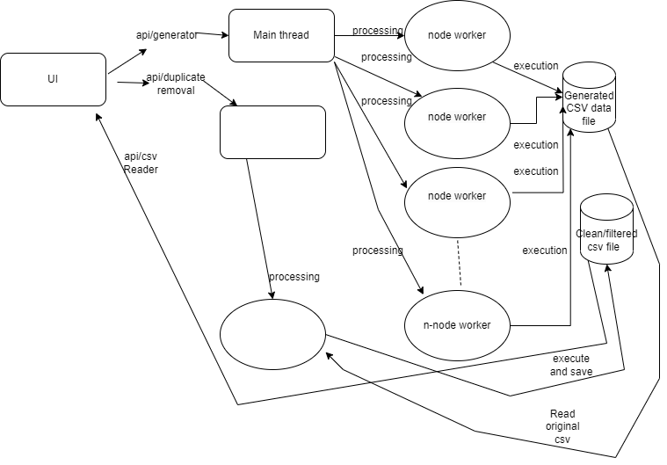
Architecture

Slide 4
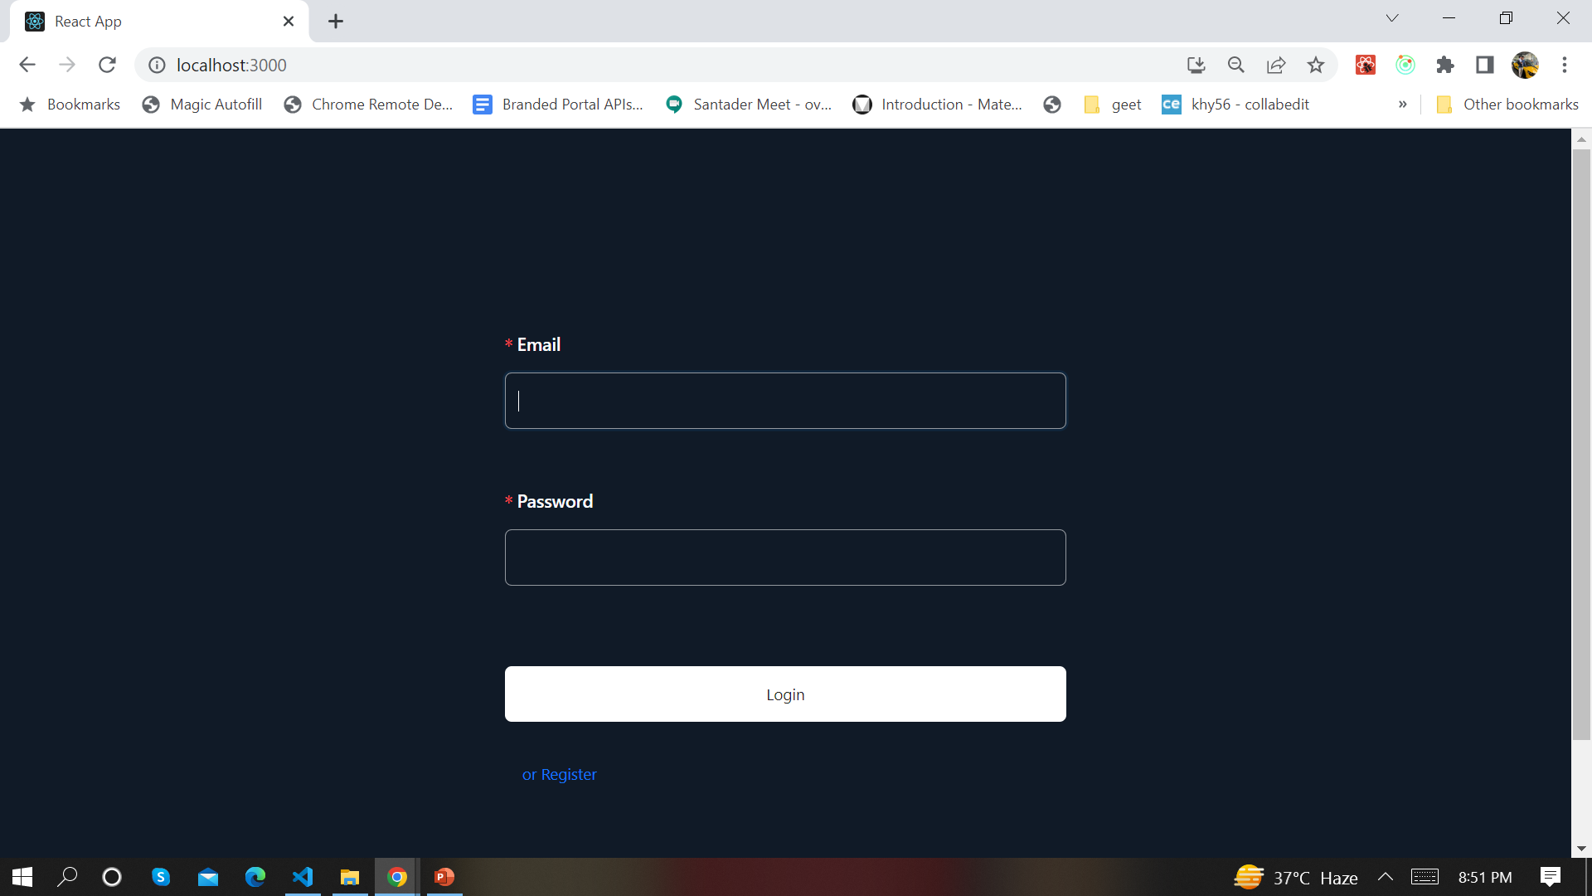
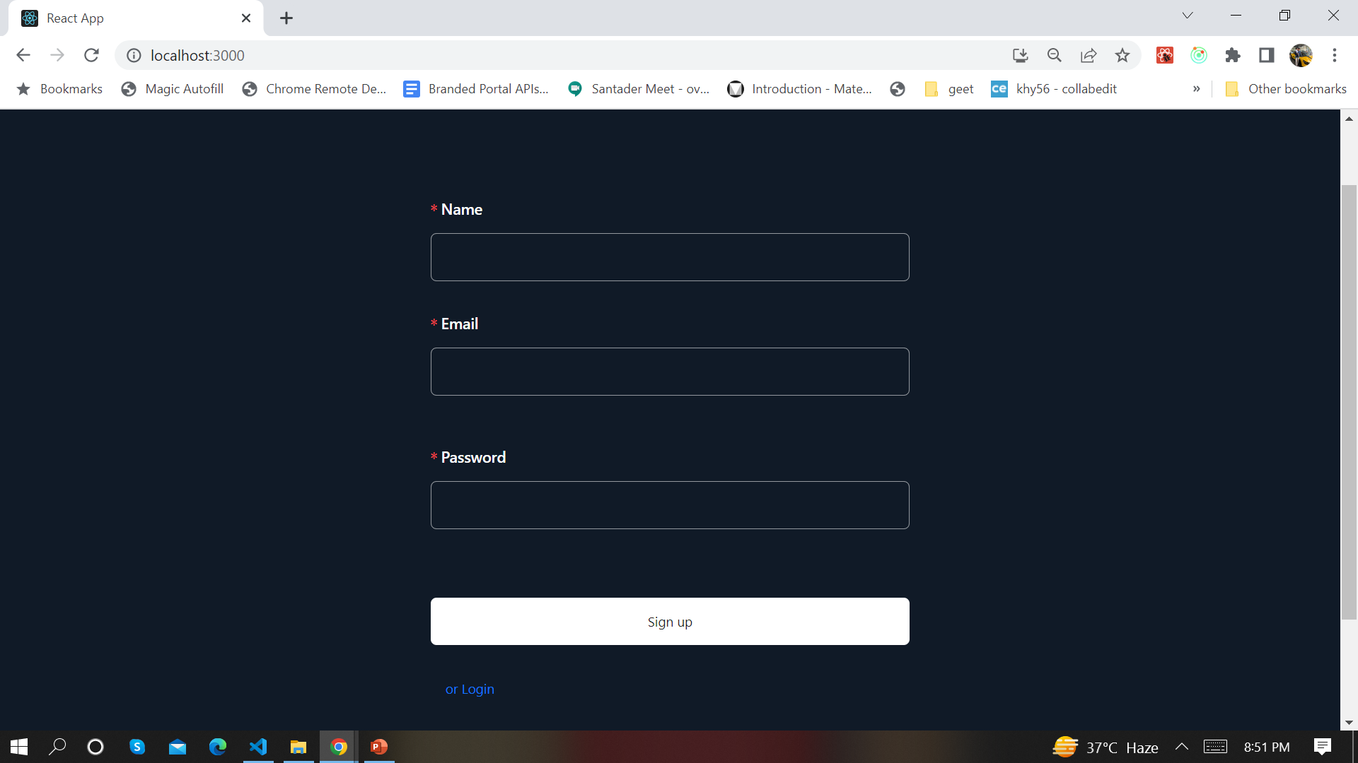
Landing page(Sign In/Register)

Slide 5
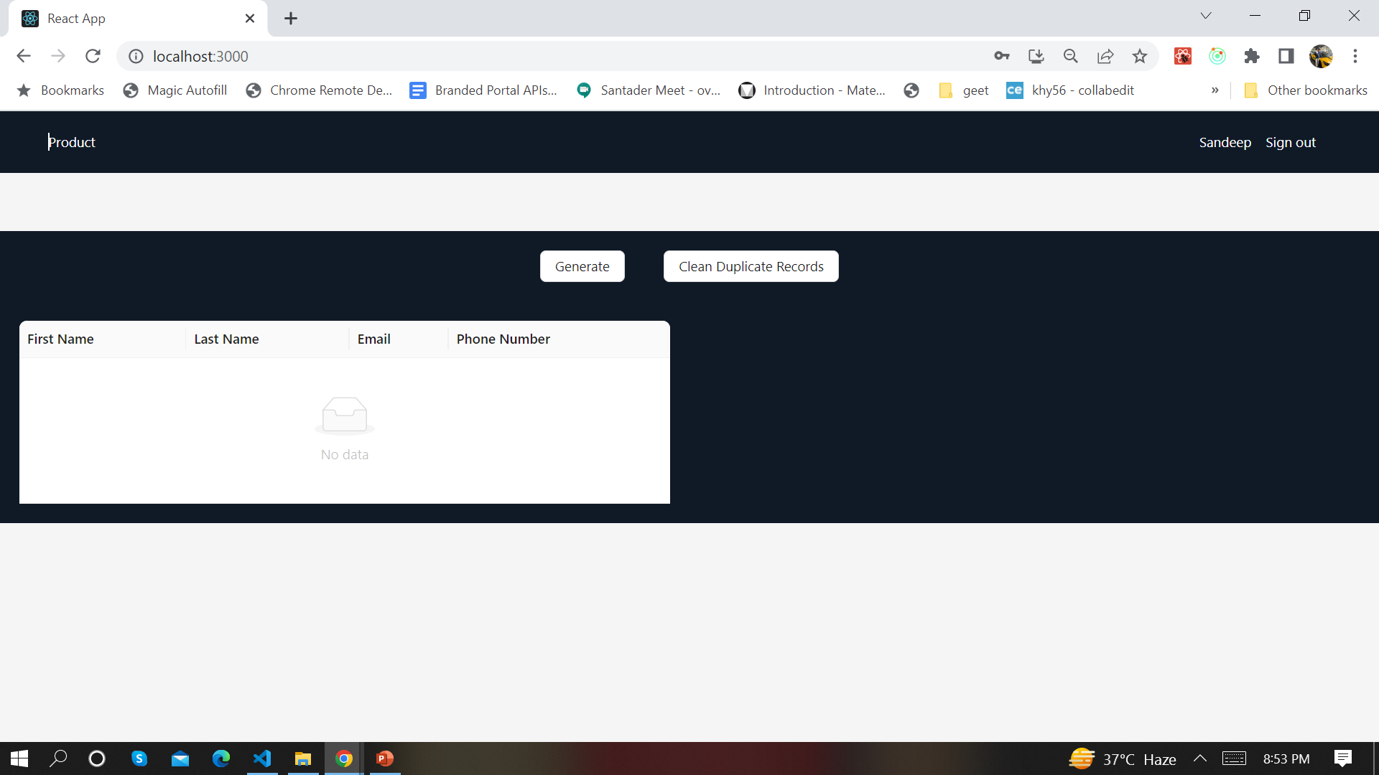
Dashboard page after login

Slide 6

Click on Generate button for generation 5 mln record

Slide 7

Click on Clean Duplicate Records

Slide 8
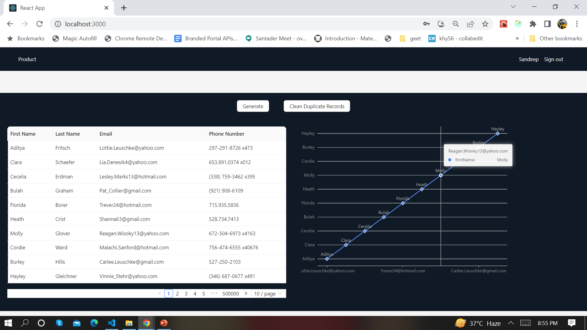
Data display with chart

Slide 9
Thank You

